Slide 1
Booking System
Lakshay Joshi

Slide 2
Agenda
ERD (Domain models)
Architecture Diagram
Frameworks
Design Patterns
API Contracts
Code Snippets

Slide 3
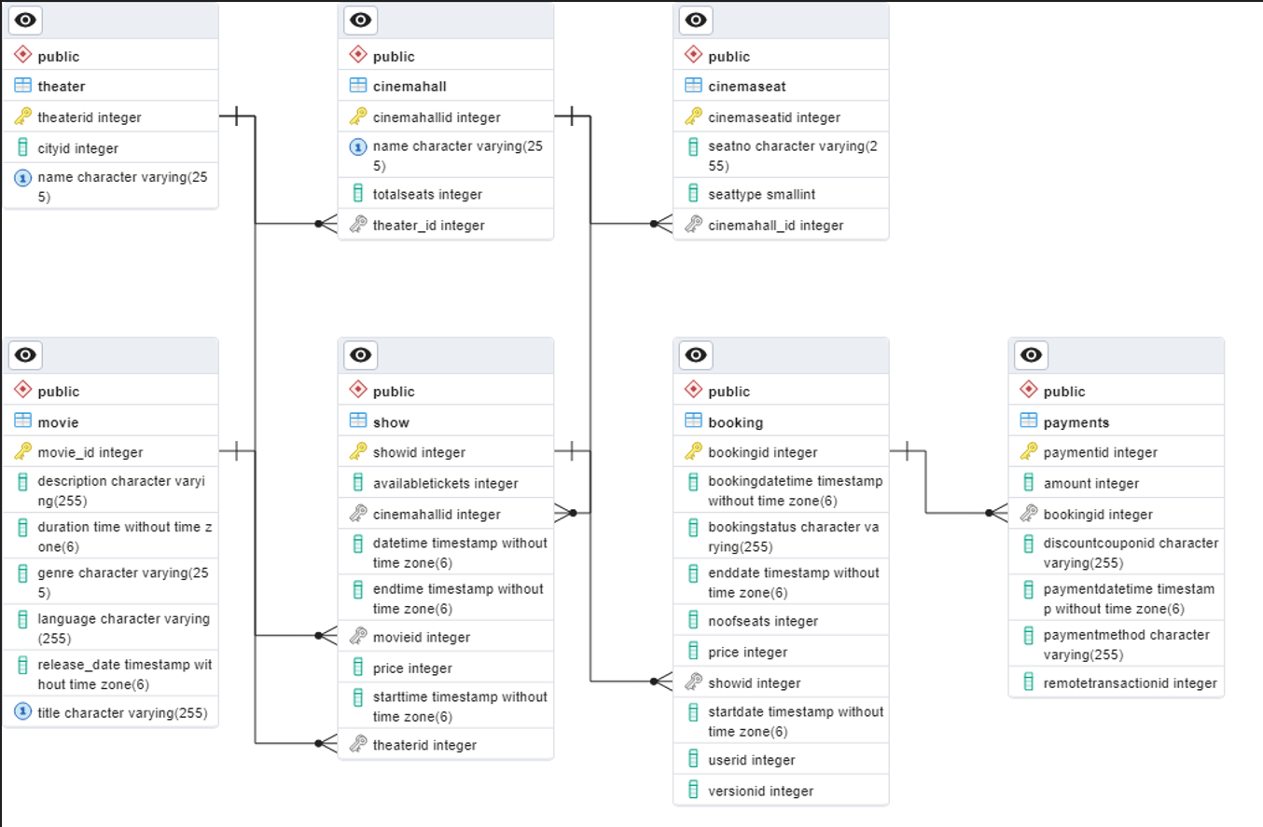
ERD

Slide 4
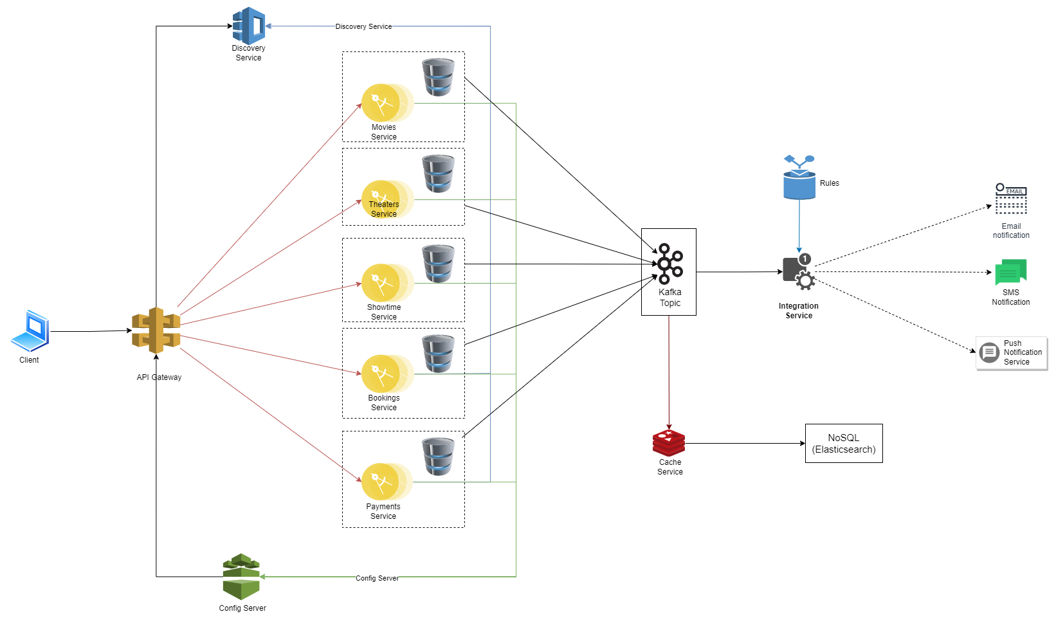
Architecture Diagram
NOTE: No cloud specific component used. (especially API Gateway, Discovery Service and Config Server) its all Spring

Slide 5
Frameworks & technologies
spring-boot-starter-web: for exposing REST Endpoints for COMMANDs
spring-cloud-starter-config: to have configurations at the central place and to maintain multiple environments.
spring-cloud-starter-netflix-eureka: client-side service discovery for cloud native microservices implementation
spring-cloud-starter-openfeign: to declare rest client that creates a dynamic implementation of the interface makes service to service interactions easy and support circuit breaker and makes retry logic simpler
spring-cloud-starter-circuitbreaker-resilience4j: Comes with abstract implementation, we can configure and customize as per needs.
spring-boot-starter-hateoas: Hypermedia for application state so that API integration is self explanatory be it UI or third-party consumers.
spring-boot-starter-data-jpa: To perform DB related operations including connection pooling via Hikari
camel-spring-boot-starter: For cloud agnostic integration layer where we can consume and produce message/events across multiple cloud technologies.
spring-cloud-streams: for building highly scalable event-driven microservices connected with shared messaging systems

Slide 6
Design patterns & design principles
Cloud native microservices
API Gateway
Naming service - Client-side service discovery (to make it cloud agnostic)
CQRS (Command Query Responsibility Segregation): separate service instances for READ vs WRITE throughput.
Event sourcing: To process any domain event and trigger subsequent actions like trigger notifications, track payment processing completed or not.
Database per service
Circuit breaker
Single responsibility
OpenTelemetry: Vendor neutral APIs to send data to observability backend
TODOs: State machine: State machine to track and monitor each event happening across services
TODOs: Side car proxy for

Slide 7
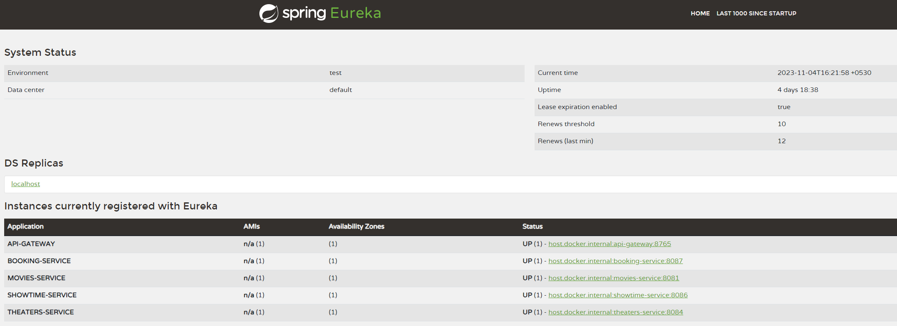
Eureka Server

Slide 8
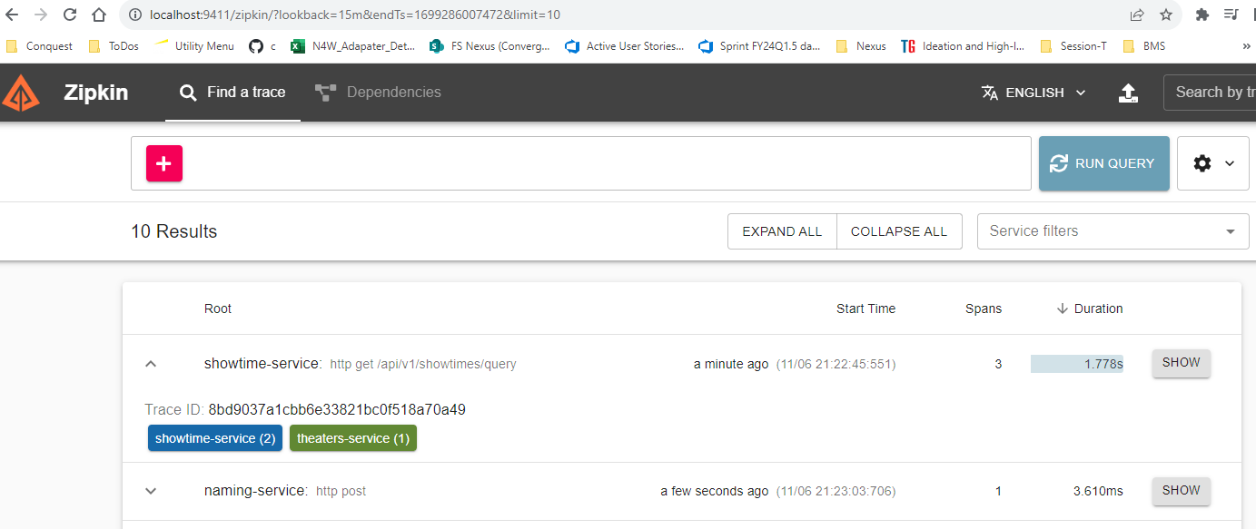
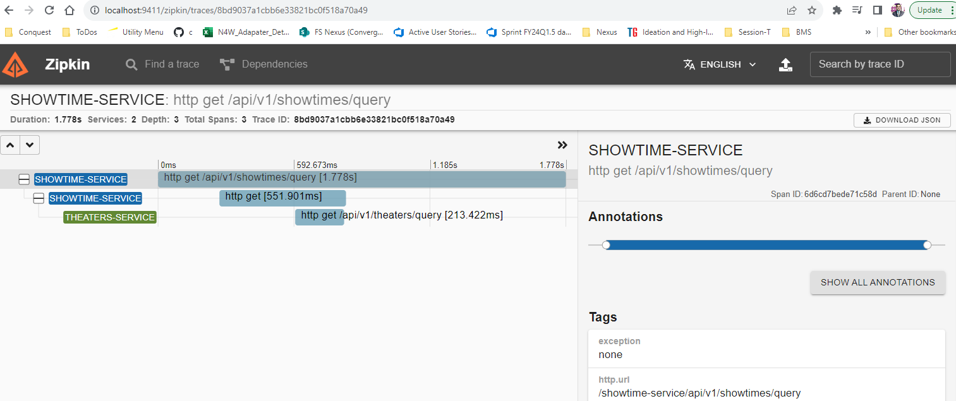
Distributed Tracing (Observability & OpenTelemetry)

Slide 9
Application port mapping
Application | Running on port
Naming-service | 8761
Api-gateway | 8765
Config-server | 8888
Movies-service | 8081
Theaters-service | 8084
ShowTime-service | 8086
Booking-service | 8087
Payments-service
Integration-service

Slide 10
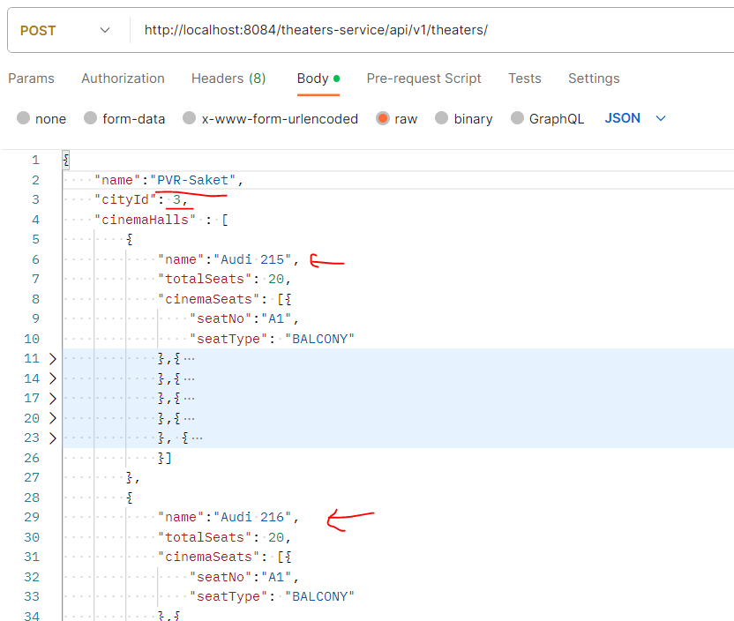
Add Theater

Slide 11
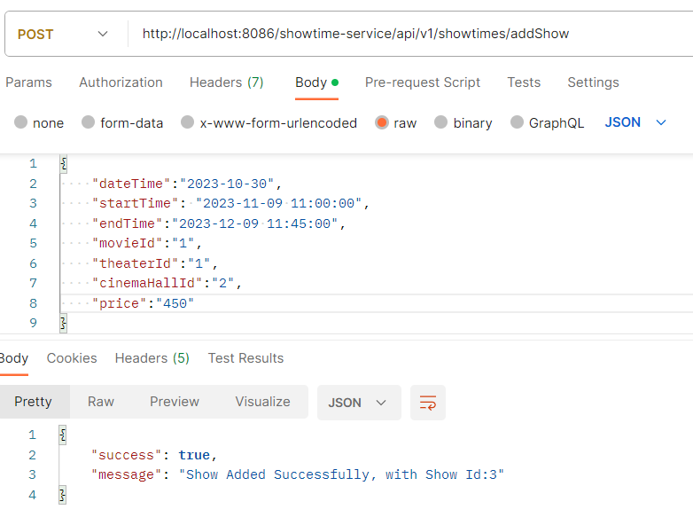
Add Show

Slide 12
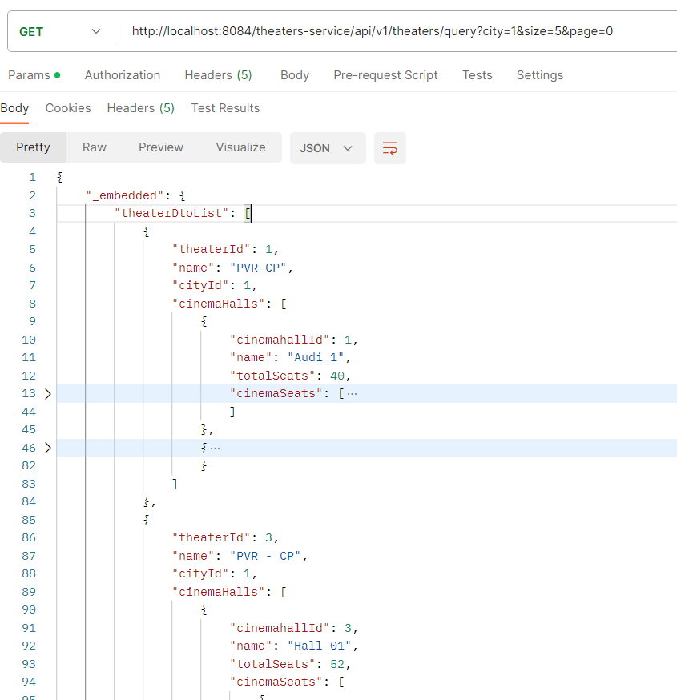
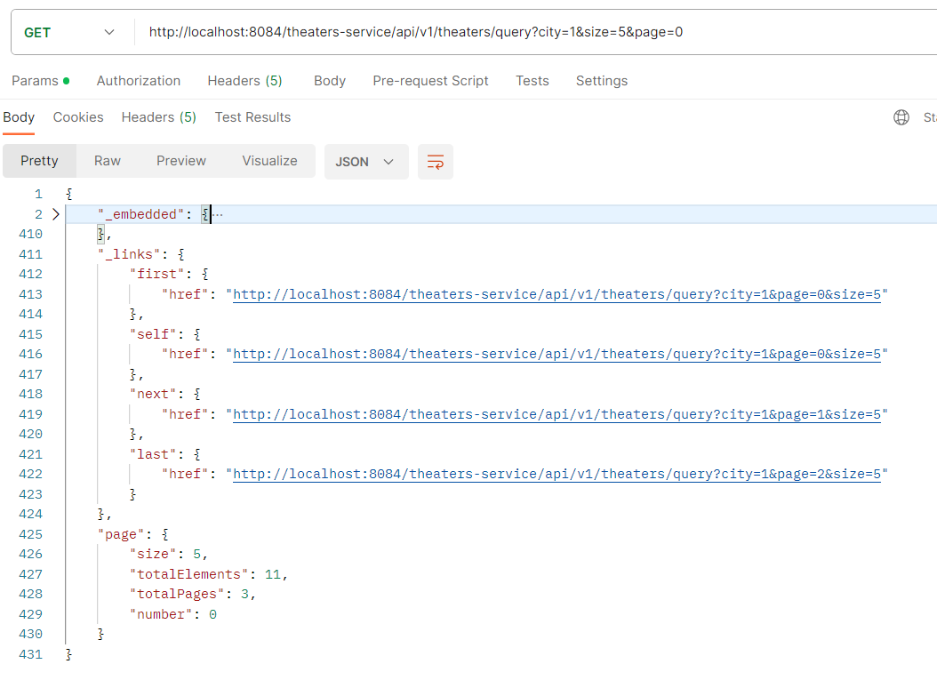
Query theaters with filters (hateoas)

Slide 13
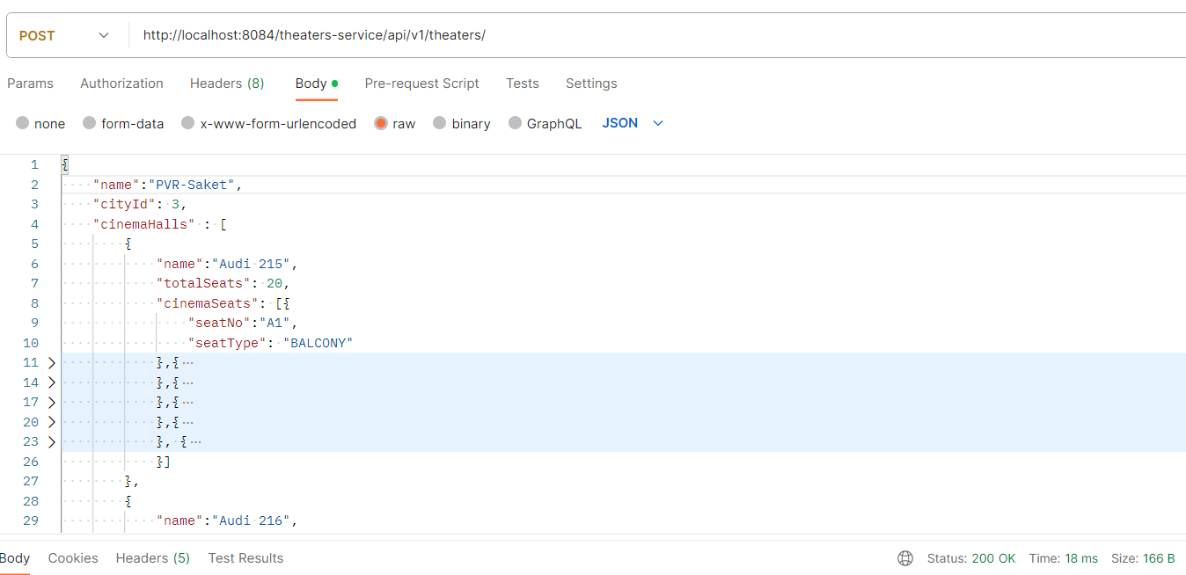
Add theaters

Slide 14
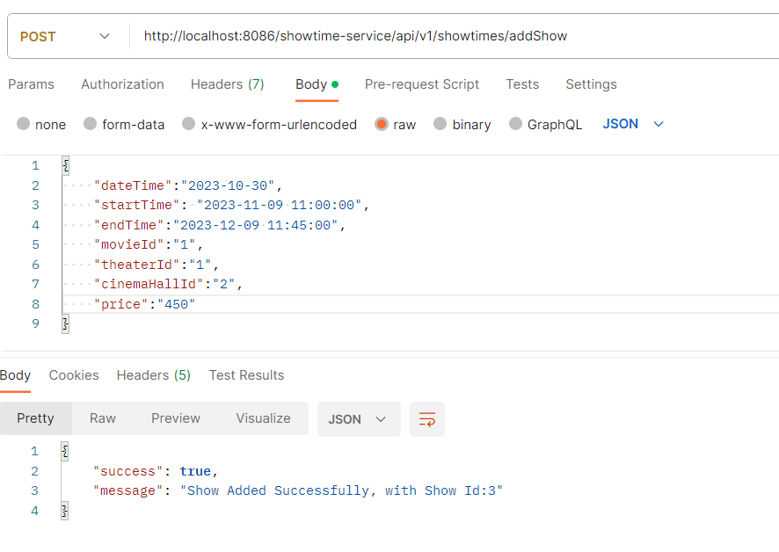
Add Shows

Slide 15
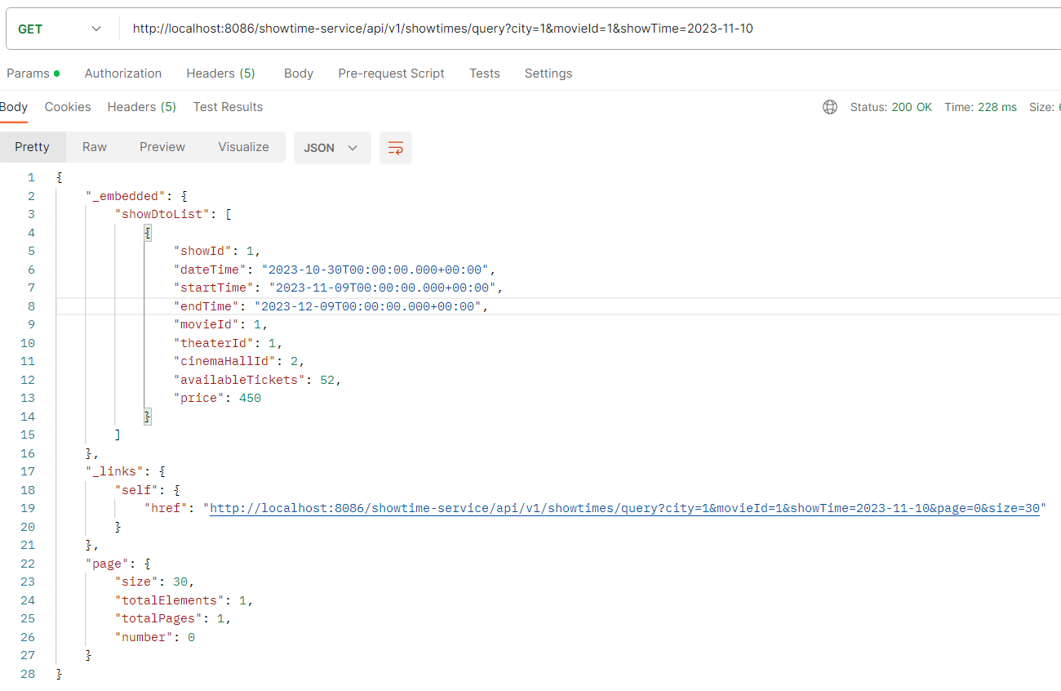
Query show (by city, movie and dateOfBooking)

Slide 16
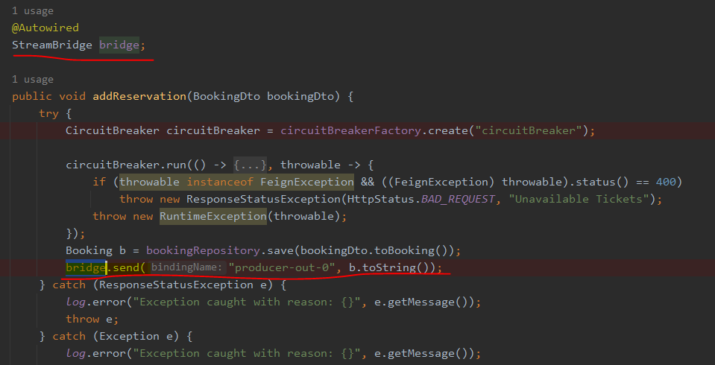
Code snippets
Spring Stream to push events

Slide 17
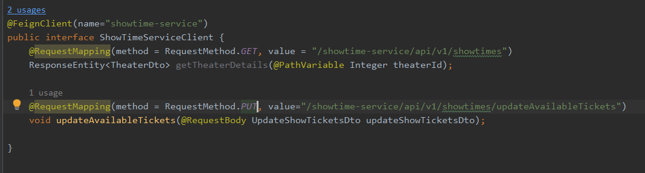

Code snippets
FeignClient

Slide 18
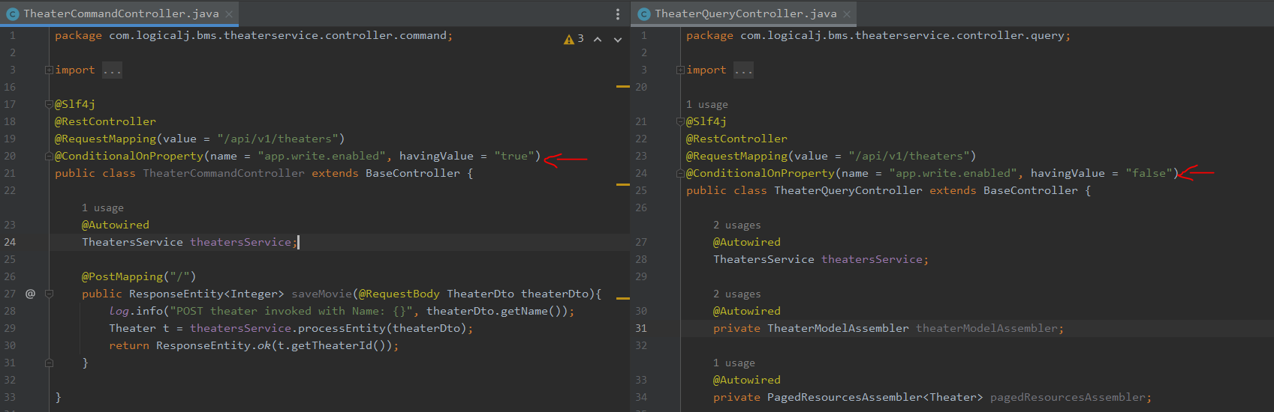
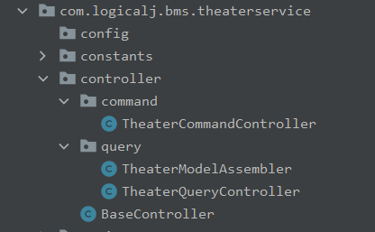
Code snippets
CQRS

Slide 19
Thank you

